Slide 1
TRACKERQUE
BUS TRACKING SYSTEM USING GPS
DHANUSRI E

Slide 2
ABSTRACT
The goal of this project is to develop a smartphone app that will allow college students to track the whereabouts of their buses in real time. The app's goal is to provide students with a stress-free, convenient, and effective way of tracking their college buses while also saving them time and keeping them updated about bus timetables. This software will allow students to quickly and easily determine the whereabouts of their college buses, the projected arrival time, and any possible delays by harnessing the power of GPS tracking and Google Maps technology. Additionally, the app will notify students if there are any emergency or unforeseen changes to the bus routes or schedules. Overall, the objective of this college bus tracking app is to provide an efficient and user-friendly transportation solution for college students.

Slide 3
INTRODUCTION
Getting to college on time can be difficult in today's fast-paced society. Students frequently rely buses to get to college on time.
It may lead the Students missing courses or crucial events due to traffic, unforeseen delays, or unknown routes. This is when a college bus tracking system comes in handy.
So we planned to provide real-time information to students, teachers, and administrators by establishing a bus tracking system, allowing them to follow the exact location of the bus, the expected time of arrival, and any potential delays.
This project intends to design and create a college bus tracking system to improve student transportation, increase safety, and save time for all college bus users.

Slide 4
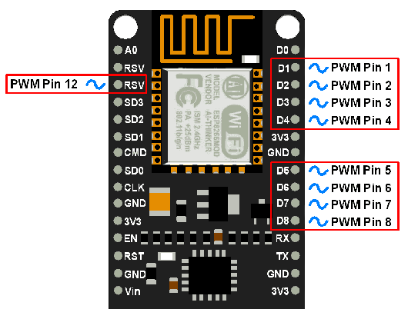
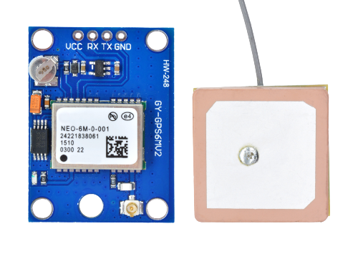
COMPONENTS USED
NODE MCU
GPS MODULE

Slide 5
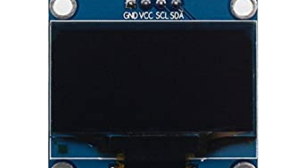
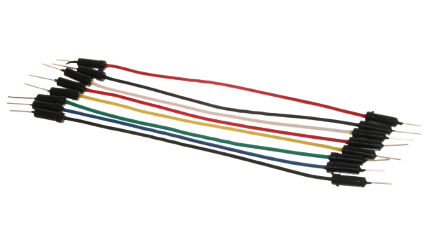
COMPONENTS USED
OLED
JUMPER WIRES

Slide 6
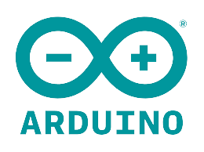
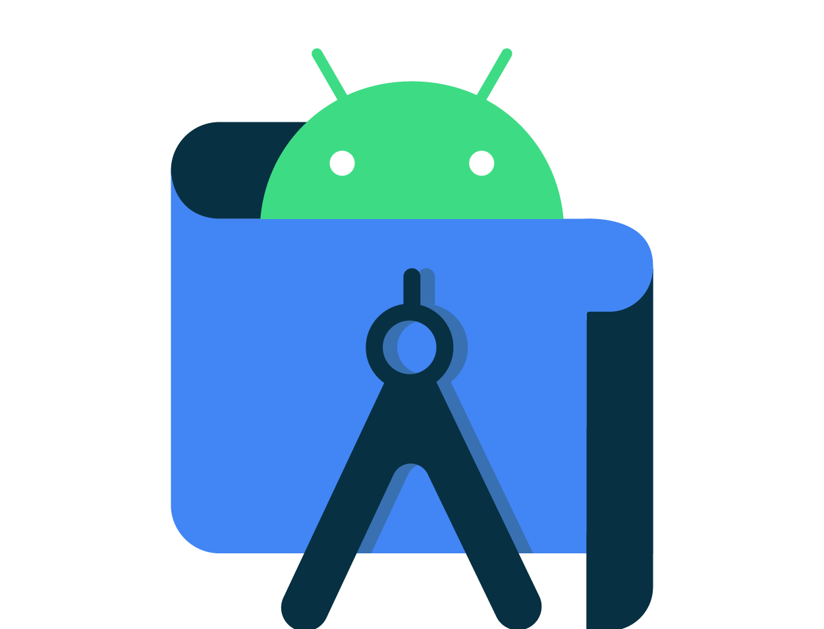
SOFTWARE USED
ARDUINO IDE
ANDROID STUDIO

Slide 7
BLOCK DIAGRAM

Slide 8
ALGORITHM
The end-user of the app, student or staff use their mobile device to access the college bus tracking in his smartphone or tablet that the user carries with them. It must have internet connectivity and GPS The application that the user installs and interacts with. It enables them to view real-time bus locations and schedules, receive alerts and notifications, and request on-demand services. it works on the basis of IT systems and databases that support the app's functionality, including GPS Tracking System which does satellite communication and collect the location details Bus Scheduling System maintains the data of bus timetable and locations in it User Database stores the data in in it the data is stored in the server and the data can be accessed through the app TRACKERQUE

Slide 9
OBJECTIVES
To deliver an efficient and accurate system for tracking college buses in real time for enhanced administration and student safety.
To create an efficient and easy to use mobile application which enables students and staff to track bus location, and get notifications about changes in bus routes or timetables.
Reduce waiting times and the frequency of missed buses by introducing an automated system that improves bus routes and schedules based on demand.
To improve communication between college administration, drivers, and passengers by offering a two-way communication channel through which users can submit difficulties, feedback, or emergency situations.

Slide 10
CONCLUSION
Finally, the college bus tracking software is innovative and essential for the efficient functioning of college transportation. Students can use this app to stay informed about bus routes and schedules, reducing waiting time and increasing productivity. Furthermore, the real-time tracking tool offers precise information about the buses' whereabouts, ensuring on-time pickups and drop-offs. Students may access information whenever and wherever they want thanks to the app's user-friendly UI and easy navigation. Overall, the college bus tracking software is a fantastic addition to campus transportation, providing students with convenience, efficiency, and safety.

